Slide 1
Bell Work
Tell me as much as you can about
the following two points.
(2, 6) and (-4, 18)

Slide 2
From Last Time…
Page 23 #86
Page 33 #33, 57, 65, 120
Page 49 #37, 51, 75, 79, 97
Page 61 #9-11

Slide 3
Pre-calc trig
Day 9

Slide 4
Objective
Manipulate functions and discuss their domain and range
Review main concepts for Test

Slide 5
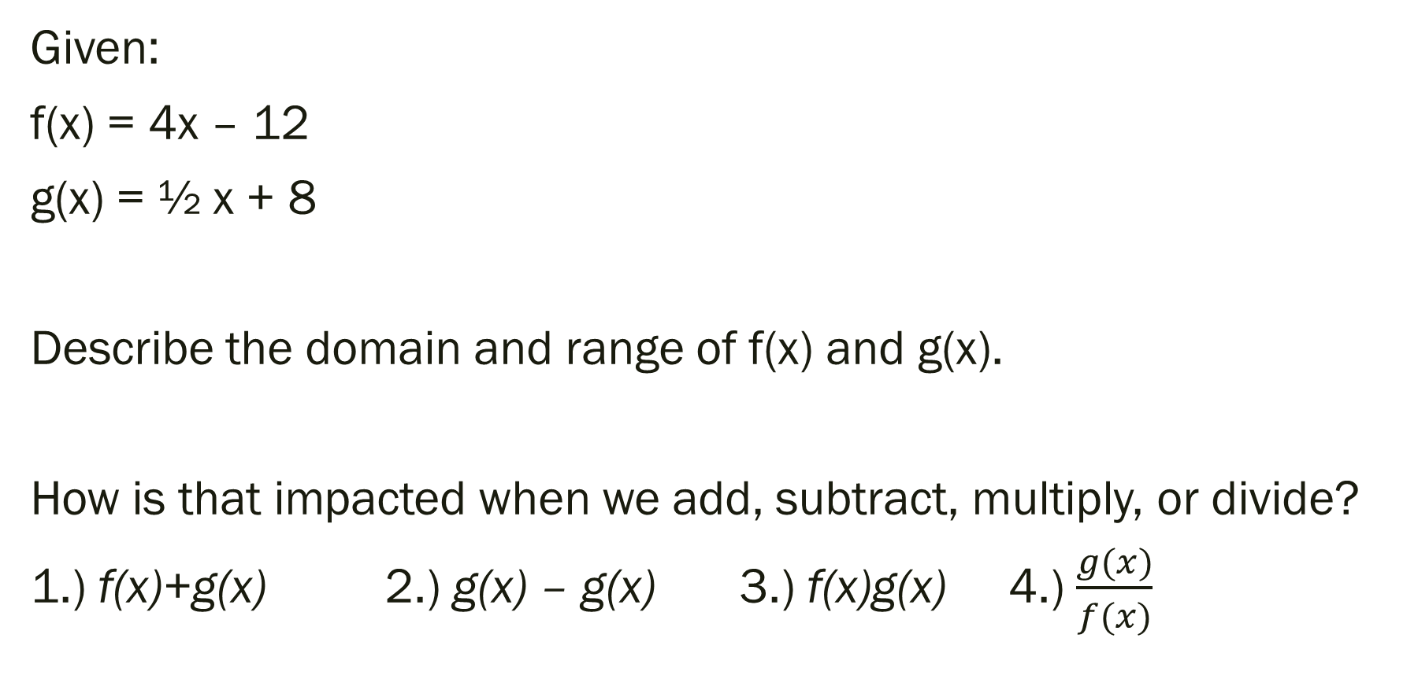
Functions and Their Graphs [Back to Bell Work]
Given:
f(x) = 4x – 12
g(x) = ½ x + 8
Describe the domain and range of f(x) and g(x).
How is that impacted when we add, subtract, multiply, or divide?
1.) f(x)+g(x) 2.) g(x) – g(x) 3.) f(x)g(x) 4.) $\frac{g(x)}{f(x)}$

Slide 6

What do you notice about the graphs?
Given:
f(x) = 4x – 12
g(x) = ½ x + 8
How is the domain and range impacted?
1.) f(x)+g(x) 2.) g(x) – g(x) 3.) f(x)g(x) 4.) $\frac{g(x)}{f(x)}$

Slide 7
What about composite functions?
Given:
f(x) = 4x – 12
g(x) = ½ x + 8
Simplify and describe the domain and range:
1.) g(g(x))
2.) f(g(m))

Slide 8
For Next Time…
Page 121 #1, 3, 7, 9, 10, 11, 19
Page 123 #3, 6

